Slide 1
Computer Architecture
A Quantitative Approach, Sixth Edition
Chapter 2
Memory Hierarchy Design
Part 2: Beyond the Basics
“Ideally one would desire an indefinitely large memory capacity such that any particular … word would be immediately available. … We are … forced to recognize the possibility of constructing a hierarchy of memories, each of which has greater capacity than the preceding but which is less quickly accessible.”
– A. W. Burks, H. H. Goldstine, and J. von Neumann, Preliminary Discussion of the Logical Design of an Electronic Computing Instrument (1946)

Slide 2
Acknowledgements
Thanks to many sources for slide material
© 1990 Morgan Kaufmann Publishers, © 2001-present Elsevier
Computer Architecture: A Quantitative Approach by J. Hennessy & D. Patterson
© 1994 Morgan Kaufmann Publishers, © 2001-present Elsevier
Computer Organization and Design by D. Patterson & J. Hennessy
© 2002 K. Asinovic & Arvind, MIT
© 2002 J. Kubiatowicz, University of California at Berkeley
© 2006, © 2010 No Starch Press for Inside the Machine by J. Stokes
© 2007 W.-M. Hwu & D. Kirk, University of Illinois & NVIDIA
© 2007-2010 J. Owens, University of California at Davis
© 2010 CRC Press for Introduction to Concurrency in Programming Languages by M. Sottile, T. Mattson, and C. Rasmussen
© 2017, IBM POWER9 Processor Architecture by Sadasivam et al., IBM
© 2016, © 2019 POWER9 Processor User’s Manual, IBM
© The OpenPOWER Foundation

Slide 3
Memory Hierarchy
Key: $ = cache
L1
$
L2
$
L3
$
Memory
Disk Storage
CPU
Memory
bus
I/O
bus
Registers
Register
reference
Level 1 $
reference
Level 2 $
reference
Level 3 $
reference
Memory
reference
Disk memory
reference
Size:
Speed:
1000 bytes
0.3 ns
64 kB
1 ns
256 kB
3-10 ns
8-16 MB
20-30 ns
8-16 GB
80-100 ns
1-8 TB
5,000,000-10,000,000 ns
L1
$
L2
$
Memory
FLASH Memory
CPU
Memory
bus
I/O
bus
Registers
Register
reference
Level 1 $
reference
Level 2 $
reference
Memory
reference
FLASH memory
reference
Size:
Speed:
500 bytes
0.3 ns
64 kB
2 ns
256 kB
10-20 ns
4-6 GB
80-100 ns
256-512 GB
25,000-50,000 ns

Slide 4
Basic Cache Optimizations
Review Appendix B, as needed.
Larger block size
Reduces compulsory misses
Increases capacity and conflict misses, increases miss penalty
Larger total cache capacity to reduce miss rate
Increases hit time, increases power consumption
Higher associativity
Reduces conflict misses
Increases hit time, increases power consumption
Higher number of cache levels
Reduces overall memory access time, increases complexity
Giving priority to read misses over writes
Reduces miss penalty, increases complexity
Avoiding address translation in cache indexing
Reduces hit time
Notes:
Caching must cope with translation of virtual address to physical address.
Common optimization: Use the page offset, i.e., the part that is identical in both virtual and physical addresses, to index the ache.

Slide 5
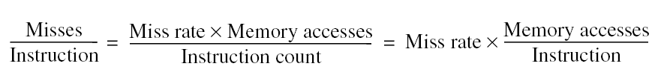

Recall: Avg. Memory Access Time
How to reduce the average memory access time?
Reduce hit time
Reduce miss rate
Reduce miss penalty
Notes:
Obvious answers:
Reduce hit time.
Reduce miss rate.
Reduce miss penalty.

Slide 6
Advanced Optimizations for Caching
Reduce Hit Time
(1) Small & simple first-level $ and (2) way prediction
Side effect: Reduce power consumption
Increase Cache Bandwidth
(3) Pipelined $, (4) non-blocking $, and (5) multi-banked $
Side effect: Varying impacts on power consumption
Reduce Miss Penalty
(6) Critical word first and (7) merging write buffers
Side effect: Little impact on power
Reduce Miss Rate
(8) Compiler optimizations. Side effect: Reduces power consumption
Reduce Miss Penalty or Miss Rate via Parallelism
(9) Hardware pre-fetching and (10) compiler pre-fetching
Key
$ = cache
Notes:
https://www.coursera.org/lecture/comparch/cache-pipelining-Nfcjx
Pre-fetching generally increases power consumption, primarily due to prefetched data that is unused.

Slide 7
Advanced Optimizations for Caching
Reduce Hit Time
(1) Small & simple first-level $ and (2) way prediction
Side effect: Reduce power consumption
Increase Cache Bandwidth
(3) Pipelined $, (4) non-blocking $, and (5) multi-banked $
Side effect: Varying impacts on power consumption
Reduce Miss Penalty
(6) Critical word first and (7) merging write buffers
Side effect: Little impact on power
Reduce Miss Rate
(8) Compiler optimizations. Side effect: Reduces power consumption
Reduce Miss Penalty or Miss Rate via Parallelism
(9) Hardware pre-fetching and (10) compiler pre-fetching
Key
$ = cache
Notes:
Pre-fetching generally increases power consumption, primarily due to prefetched data that is unused.

Slide 8
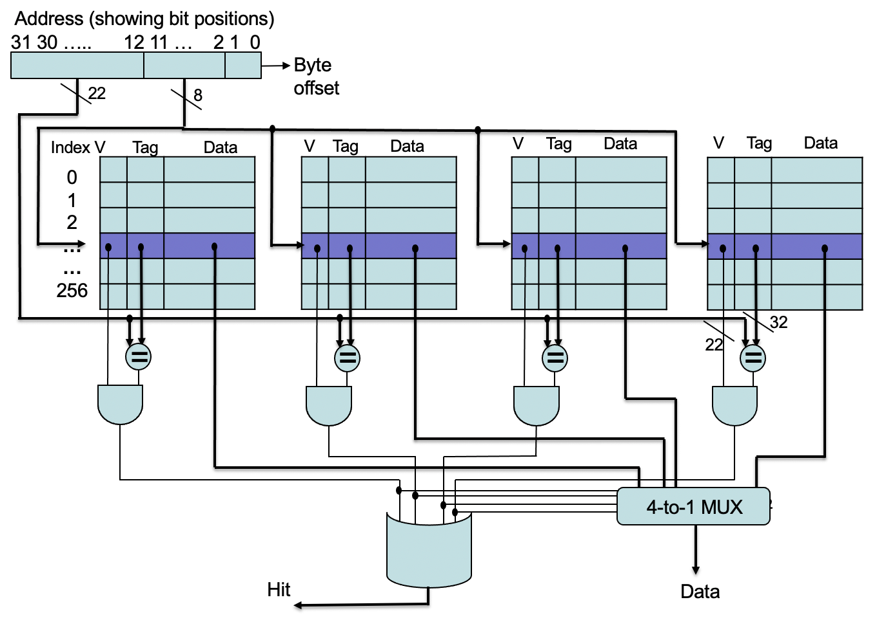
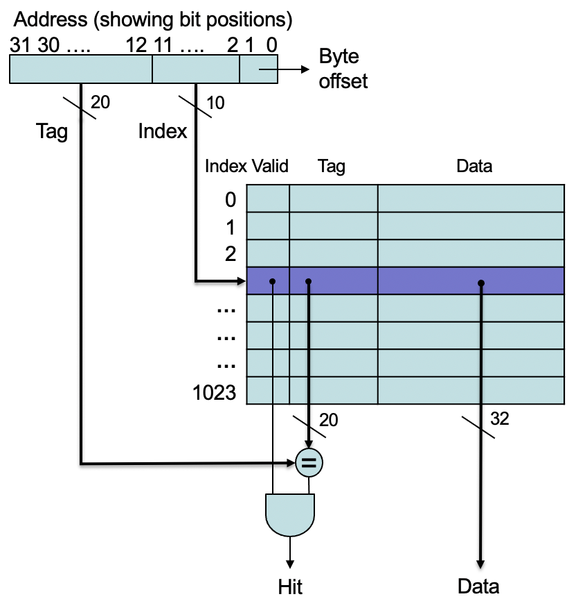
Small & Simple First-Level Caches
Critical timing path
addressing tag memory, then
comparing tags, then
selecting correct set
Direct-mapped caches can overlap tag compare and transmission of data
Lower associativity reduces power because fewer cache lines are accessed
Notes:
Pressure of fast clock cycle and lower power consumption encourages smaller L1 caches.
Critical timing path is a three-stage process:
Addressing the tag memory using the index portion of the address
Comparing the read tag value to the address
Setting the MUX to choose the correct data item if the cache is associative
Direct-mapped cache can overlap tag compare and transmission of data to a multiplexer.

Slide 9
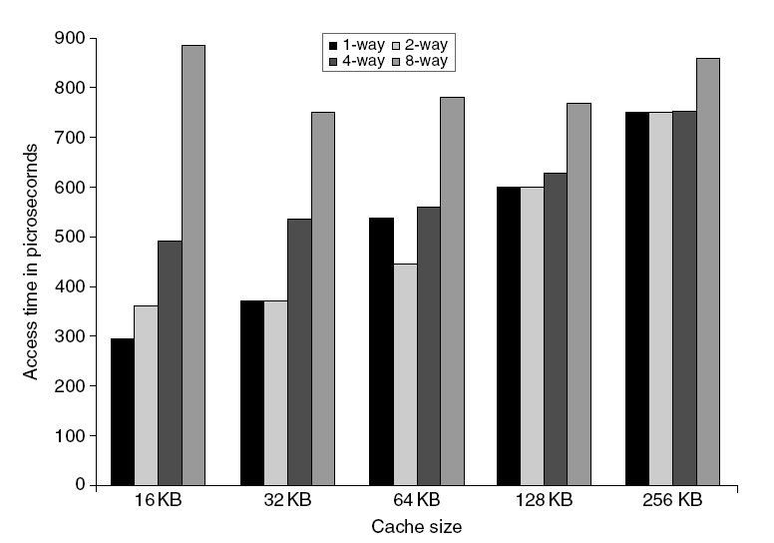
L1 Size and Associativity
Access time vs. size and associativity
Notes:
Depends on $ size (and technology), but ….
Hit time for direct mapped faster than 2-way set assoc.
2-way set assoc. is 1.2x faster than 4-way set assoc.
4-way set assoc. is 1.4x faster than 8-way set assoc.
Hit time increases by 1.2x for a marginal decrease in miss rate. Net effect: memory access time increases by increasing associativity.
(Note: Example in the book is incorrect! Make this into a homework question.)

Slide 10
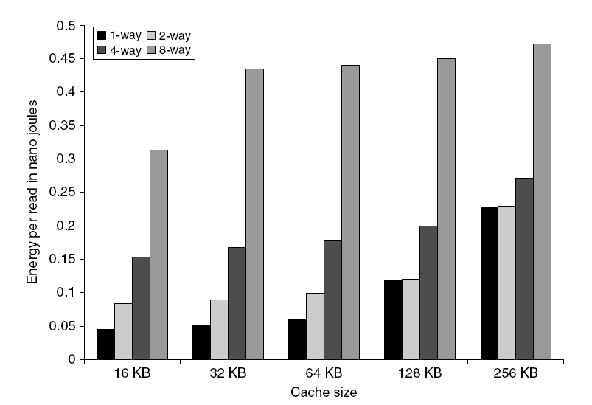
L1 Size and Associativity
Energy per read vs. size and associativity
Notes:
Energy cost for higher associativity ranges from more than a factor of two to negligible for larger $$$, e.g., 128K and 256K when going between direct-mapped and 2-way.

Slide 11
Way Prediction: Predict the “Way” or Block within the Set
To improve hit time, predict the “way” to pre-set mux
Misprediction gives longer hit time
Prediction accuracy
> 90% for two-way
> 80% for four-way
I-cache has better accuracy than D-cache
First used on MIPS R10000 in mid-90s
Used on ARM Cortex-A8
Extend to predict block as well
“Way selection”
Increases misprediction penalty
How to combine fast hit time of direct-mapped $ and have the lower conflict miss rate of of 2‐way set associative $?
Notes:
Reduces conflict misses and maintains hit speed of direct-mapped cache.
Added to each block of a $ are block predictor bits. The bits select which of the blocks to try on the NEXT $ access.
If the predictor is correct, the cache access latency is the fast hit time.
If not, it tries the other block, changes the way predictor and has a latency of one extra clock cycle.
ARM Cortex-A8: A dual-issue superscalar design, achieving roughly twice the instructions executed per clock cycle.
Apple iPhone 3GS, Apple iPod touch (3rd and 4th Generation), Apple iPad (A4), Apple iPhone 4 (A4), Apple TV (Second Generation) (A4),
Motorola Droid, Motorola Droid X, Motorola Droid 2, Motorola Droid R2D2 Edition
Many of the early Google Nexus and Samsung Galaxy line

Slide 12
Advanced Optimizations for Caching
Reduce Hit Time
(1) Small & simple first-level $ and (2) way prediction
Side effect: Reduce power consumption
Increase Cache Bandwidth
(3) Pipelined $, (4) non-blocking $, and (5) multi-banked $
Side effect: Varying impacts on power consumption
Reduce Miss Penalty
(6) Critical word first and (7) merging write buffers
Side effect: Little impact on power
Reduce Miss Rate
(8) Compiler optimizations. Side effect: Reduces power consumption
Reduce Miss Penalty or Miss Rate via Parallelism
(9) Hardware pre-fetching and (10) compiler pre-fetching
Key
$ = cache
Notes:
Pipeline $ access or widen $ with multiple banks to allow multiple accesses per clock.
Pre-fetching generally increases power consumption, primarily due to prefetched data that is unused.

Slide 13
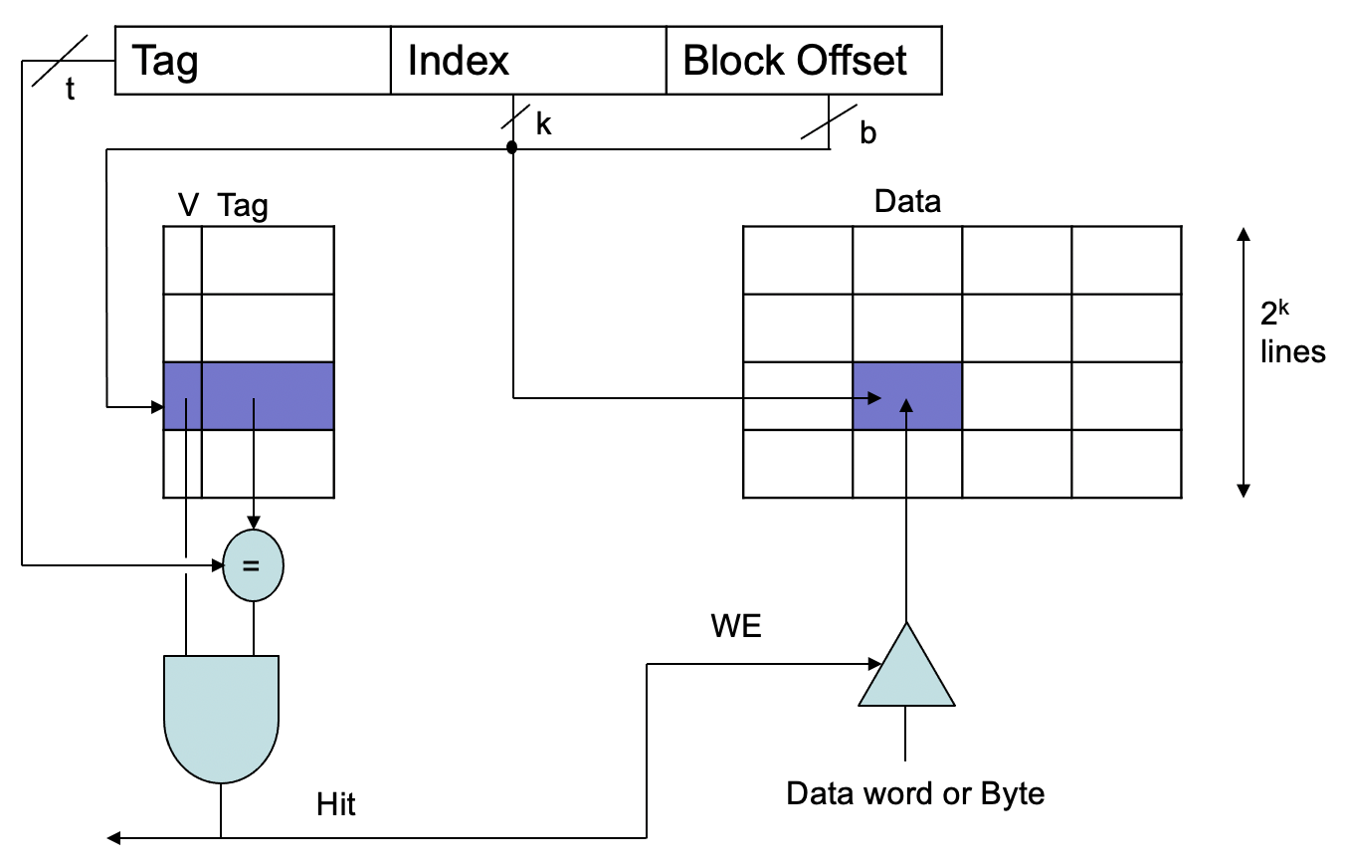
Write Performance
Steps: (1) Index tag array. (2) Compare tags. (3) Check valid bit. (4) If valid, enable write to memory location.
Serial set of steps that can be done in a single (long) cycle. Perhaps two shorter cycles?
Notes:
Why not pipeline the access? Break write into two stages: (1) Compare tags in first stage. (2) Write the data, if hit, in second stage.

Slide 14
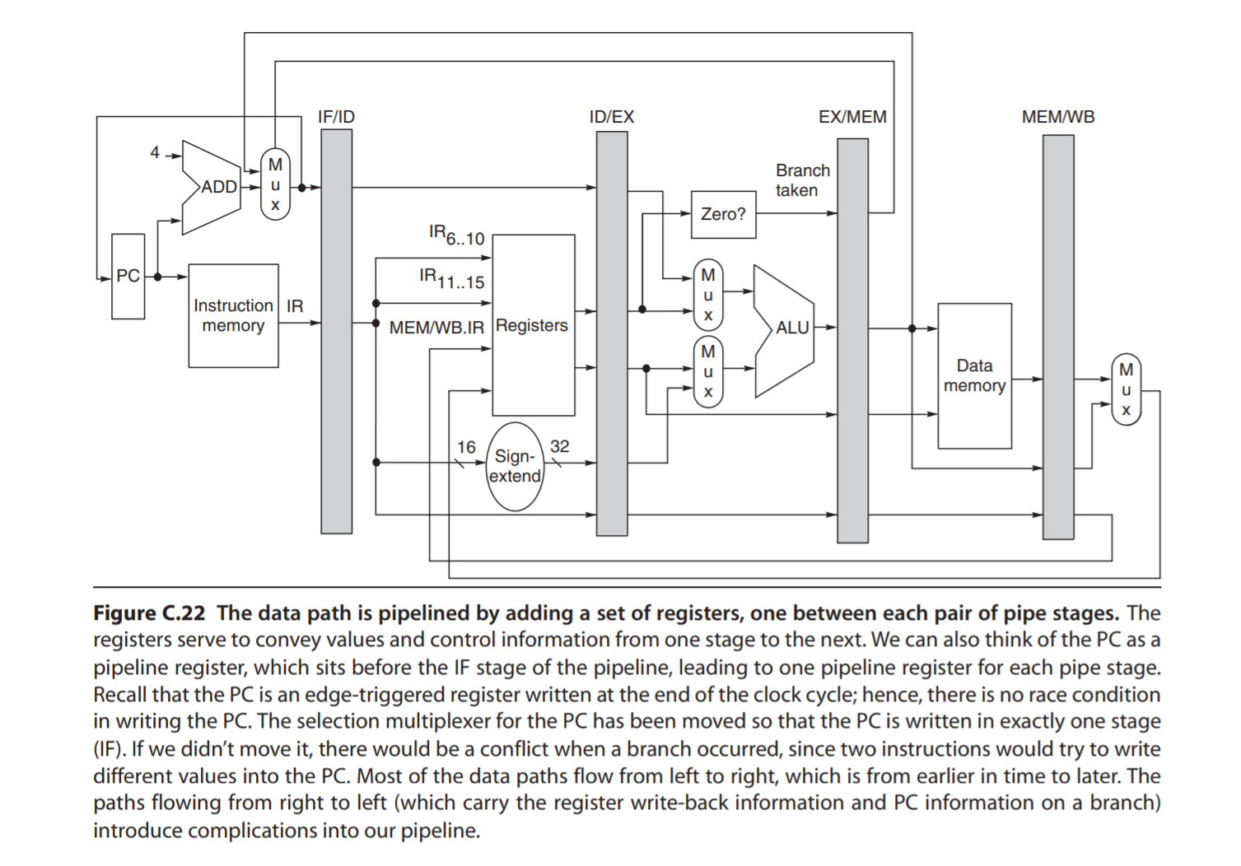
Write Performance
Problem: Writes take two cycles in the memory stage, one cycle for tag check plus one cycle for data write if hit
Solutions
Design data RAM that can perform read and write concurrently, restore old value after tag miss
Hold write data for store in single buffer ahead of the cache; write cache data during the next store’s tag check.

Slide 15
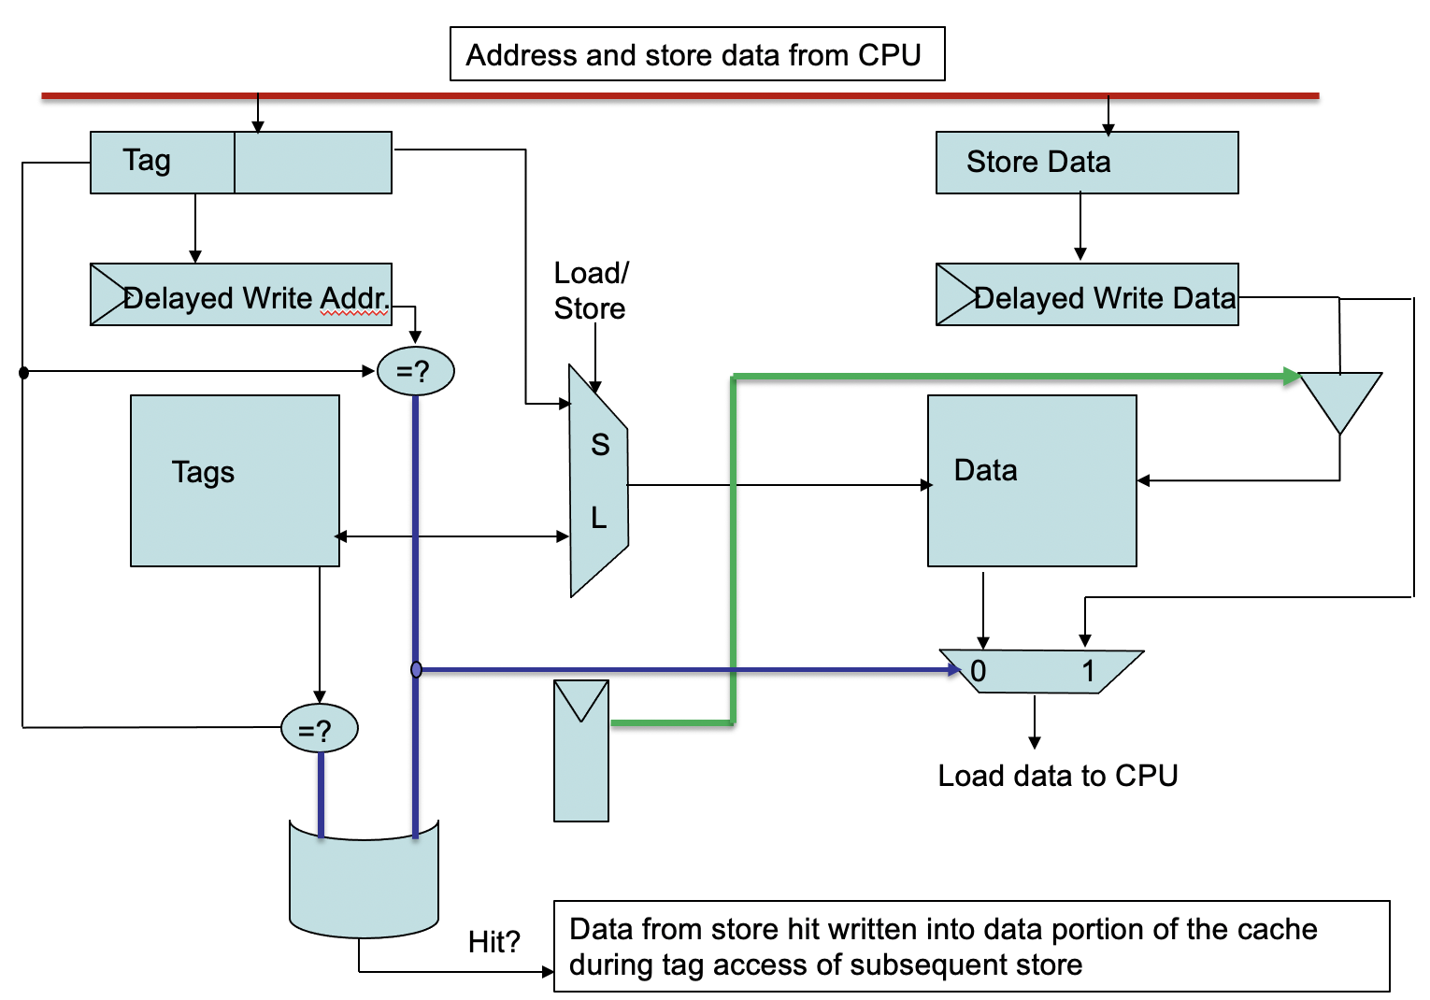
Pipelining Cache Writes
Notes:
Store the write address and data in a delayed write buffer.
When there is another subsequent store, the write buffer is eventually written into the cache.
What happens to write when you do a load and there’s data in the delayed write buffer? Bypass it. See “=?” which compares the load address and delayed write address. If the same, then load the delayed write data to the CPU (see MUX in bottom right).

Slide 16
Pipelining Cache
Pipeline cache access to improve bandwidth
Examples
Pentium: 1 cycle
Pentium Pro – Pentium III: 2 cycles
Pentium 4 – Core i7: 4 cycles
but the increased number of pipeline stages leads to …
Increases in branch misprediction penalty
Is it easier to pipeline the instruction cache or data cache?
Makes it easier to increase associativity
In practice?
All CPUs pipeline L1 cache access simply to separate the access and the hit detection stages.
When does banking work best?
Notes:
L1: primarily pipelined, as access bandwidth constrains instruction throughput. L2 & L3: generally multiple banks but as a power-management technique.
Effective latency to L1 cache is now multiple cycles BUT results in faster clock cycles times, higher bandwidth, but slower hits.
Example: Data from a store hit is written into the data portion of the cache during tag access of subsequent store.
Banking works best when accesses naturally spread across the banks, i.e., sequential interleaving. Maximum throughput.
Example: If four banks, bank 0 has all blocks whose address mod 4 is 0; bank 1 has all blocks whose address mod 4 is 1; and so on.
Multiple banks are also useful in L2 and L3 $ but for different reasons.
Can handle multiple L1 $ misses if the banks do NOT conflict, which is key in supporting non-blocking $
L2 in Intel Core i7 has 8 banks.

Slide 17
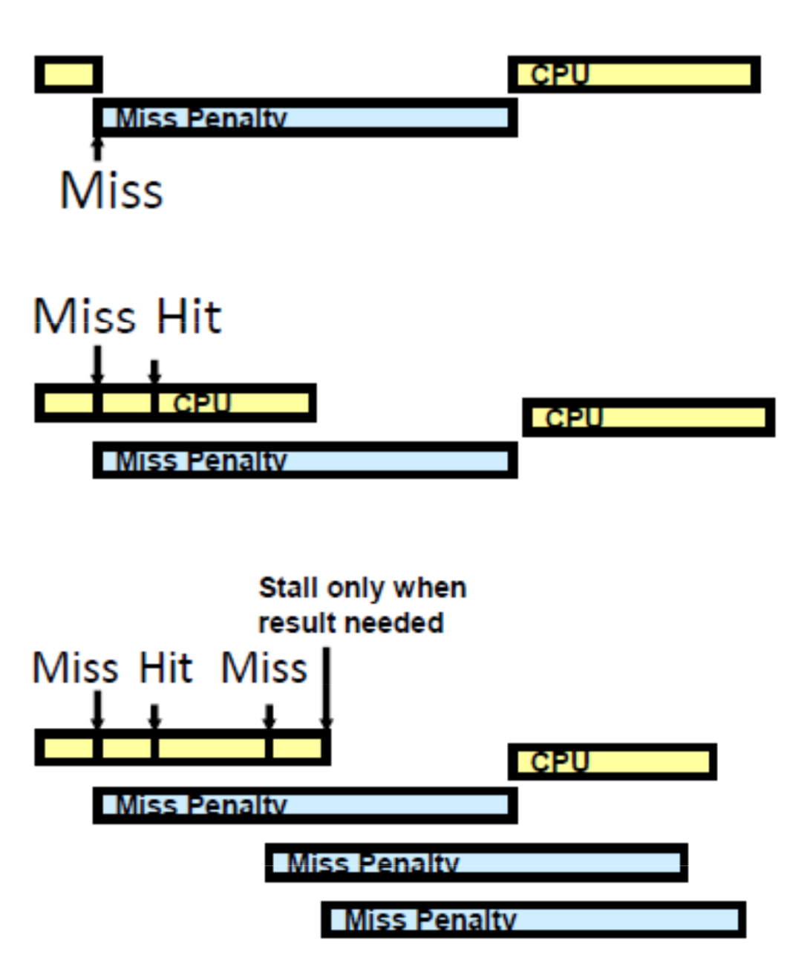
Non-blocking Caches
Stall CPU on $ Miss
Hit under $ Miss
Multiple Outstanding $ Misses
Notes:
LD R2, A
ADD R5, R3, R1
LD R4, Z
MUL R6, R4, R2
LD R7, X
OR R3, R3, R1
AND R9, R8, R5

Slide 18
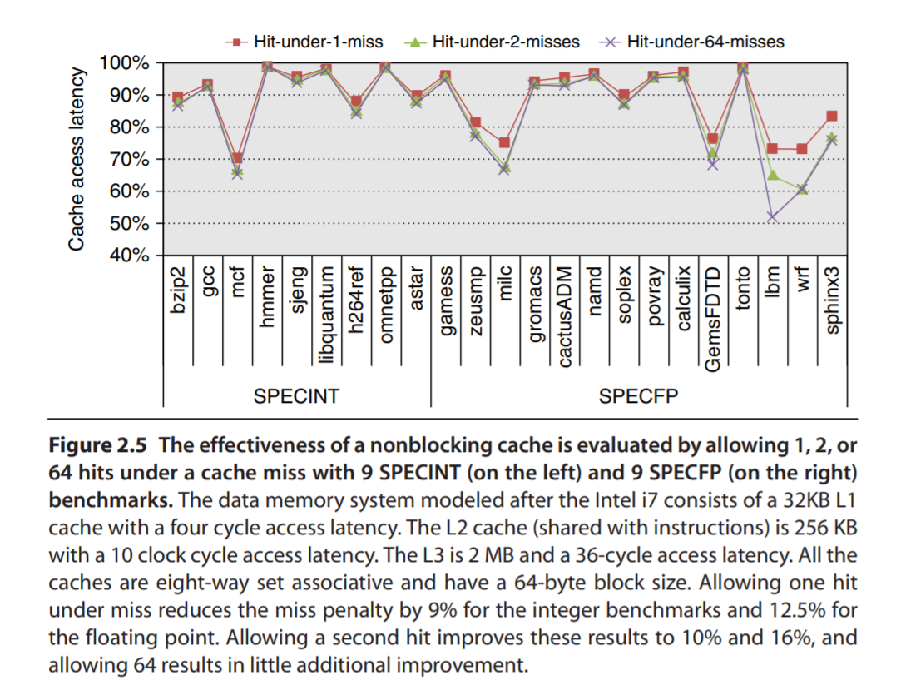
Non-blocking Caches: Basic Idea
Allow hits before previous misses complete
“Hit under miss”
“Hit under multiple miss”
L2 must support this
In general, processors can hide L1 miss penalty but not L2 miss penalty
Notes:
Reduces the cache miss penalty
Should update this slide with Figure 2.5 from textbook
Farkas and Jouppi [1994] did a study assuming 8 KB caches with a 14-cycle miss penalty; they observed a reduction in the effective miss penalty of 20% for the SPECINT92 benchmarks and 30% for the SPECFP92 benchmarks when allowing one hit under miss
Li, Chen, Brockman, and Jouppi [2011] recently updated this study to use a multilevel cache.
The larger caches and the addition of an L3 cache since the earlier study have reduced the benefits with the SPECINT2006 benchmarks showing an average reduction in cache latency of about 9% and the SPECFP2006 benchmarks about 12.5%.

Slide 19
Basic MIPS Architecture

Slide 20
Non-blocking Caches: Details
Non-blocking cache or lockup‐free cache
Allows data $ to continue to supply $ hits during a miss
“Hit under Miss”
Reduces the effective miss penalty by working during $ miss vs. ignoring CPU requests
“Hit under Multiple Miss” or “Miss under Miss”
May further lower effective miss penalty by overlapping multiple misses
Examples
Pentium Pro allows 4 outstanding memory misses
(Cray X1E vector supercomputer allows 2,048 outstanding memory misses)
Issues?
Notes:
We keep focusing on performance, but at what cost?
– requires out‐of‐order execution
– significantly increases the complexity of the cache controller as there can be multiple outstanding memory accesses
– requires pipelined or banked memory system (otherwise cannot support)

Slide 21
Non-blocking Cache: Example
Assume the following information
Sustained transfer rate: 16 GB/s
Memory-access time: 36 ns
Block size: 64 bytes
What is the maximum number of outstanding references to maintain peak bandwidth for a system?
Answer: (16*10⁹) / 64 * (36*10^{‐9}) = 9
Notes:
(16*10⁹) / 64 = 250M memory references / second
Because each reference takes 36 ns, then 250M memory references / second * 36*10^{‐9} second = 9 references.
If probability of collision greater than 0, then we need more outstanding references because we cannot start work on colliding references; the memory system needs more independent references, not fewer. So, in this case, 50% not issued, so we need to support twice as many outstanding references = 18.

Slide 22
Non-blocking Cache: Example
Assume the following information
Sustained transfer rate: 16 GB/s
Memory-access time: 36 ns
Block size: 64 bytes
50% of references need not be issued (i.e., if probability of a reference colliding with previous references is 50%)
What is the maximum number of outstanding references to maintain peak bandwidth for a system?
Answer: (16*10⁹) / 64 * (36*10^{‐9}) * 2 = 18
Notes:
(16*10⁹) / 64 = 250M memory references / second
Because each reference takes 36 ns, then 250M memory references / second * 36*10^{‐9} second = 9 references.
If probability of collision greater than 0, then we need more outstanding references because we cannot start work on colliding references; the memory system needs more independent references, not fewer. So, in this case, 50% not issued, so we need to support twice as many outstanding references = 18.

Slide 23
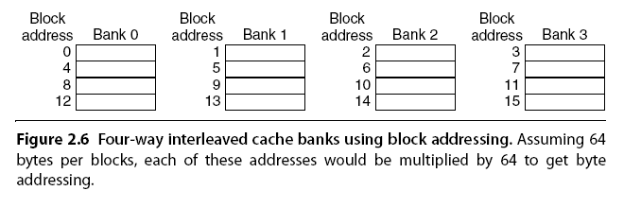
Multi-banked Caches
Organize cache as independent banks to support simultaneous access
ARM Cortex-A8 supports 1-4 banks for L2
Intel Core i7 supports 4 banks for L1 and 8 banks for L2
Interleave banks according to block address
Simple mapping that works well? “Sequential Interleaving”
Spread block addresses sequentially across banks
Example: If 4 banks, Bank 0 has all blocks whose address mod 4 is 0; bank 1 has all blocks whose address mod 4 is 1; ...
Notes:
Divide cache into independent banks that can support simultaneous accesses.
Banks were originally used to improve performance of main memory. Now useful in smaller DRAM chips as well as caches.
Clearly, banking works best when accesses naturally spread themselves across the banks.

Slide 24
Advanced Optimizations for Caching
Reduce Hit Time
(1) Small & simple first-level $ and (2) way prediction
Side effect: Reduce power consumption
Increase Cache Bandwidth
(3) Pipelined $, (4) non-blocking $, and (5) multi-banked $
Side effect: Varying impacts on power consumption
Reduce Miss Penalty
(6) Critical word first and (7) merging write buffers
Side effect: Little impact on power
Reduce Miss Rate
(8) Compiler optimizations. Side effect: Reduces power consumption
Reduce Miss Penalty or Miss Rate via Parallelism
(9) Hardware pre-fetching and (10) compiler pre-fetching
Key
$ = cache
Notes:
Pre-fetching generally increases power consumption, primarily due to prefetched data that is unused.

Slide 25
Critical Word First or Early Restart Don’t wait for full block before restarting CPU
Critical Word First
Request missed word from memory first
Send it to the processor as soon as it arrives
Let processor continue execution while filling the rest of the words in the block
Early Restart
Request words in normal order
Send missed work to the processor as soon as it arrives
Let the CPU continue execution
Effectiveness of these strategies depends on block size and likelihood of another access to the portion of the block that has not yet been fetched
Which one more widely used? Why?
Notes:
These techniques are based on the observation that the CPU normally needs just one word of the block at a time.
These techniques only benefit designs with large cache blocks. Why?
Which technique likely of most benefit? Critical Word First, which is widely used. Why?
1. Larger block sizes more popular today.
2. Spatial locality tends to want next sequential word anyway.

Slide 26
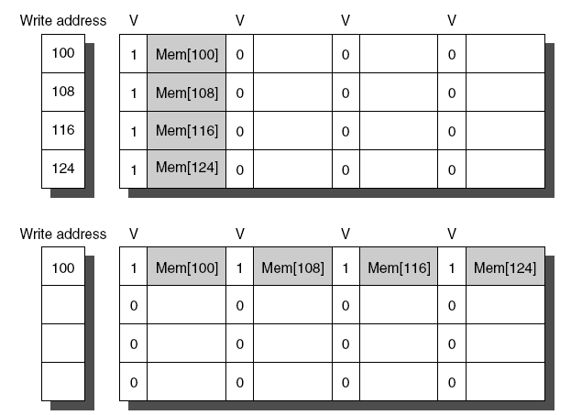
Merging Write Buffer
When storing to a block that is already pending in the write buffer, update write buffer
Reduces stalls due to full write buffer
Do not apply to I/O addresses
No write buffering
Write buffering
Notes:
Write buffer to allow processor to continue while waiting to write to memory
• If buffer contains modified blocks, the addresses can be checked to see if address of new data matches the address of a valid write buffer entry
• If so, new data are combined with that entry
• Increases block size of write for write‐through cache of writes to sequential words, bytes since multiword writes more efficient to memory
To illustrate write merging, the write buffer on top does not use it while the write buffer on the bottom does. The four writes are merged into a single buffer entry with write merging; without it, the buffer is full even though three‐fourths of each entry is wasted. The buffer has four entries, and each entry holds four 64‐bit words. The address for each entry is on the left, with a valid bit (V) indicating whether the next sequential 8 bytes in this entry are occupied. (Without write merging, the words to the right in the upper part of the figure would only be used for instructions that wrote multiple words at the same time.)
conflicting design objectives, i.e. ejecting as soon as possible vs. keeping longer for merging

Slide 27
Advanced Optimizations for Caching
Reduce Hit Time
(1) Small & simple first-level $ and (2) way prediction
Side effect: Reduce power consumption
Increase Cache Bandwidth
(3) Pipelined $, (4) non-blocking $, and (5) multi-banked $
Side effect: Varying impacts on power consumption
Reduce Miss Penalty
(6) Critical word first and (7) merging write buffers
Side effect: Little impact on power
Reduce Miss Rate
(8) Compiler optimizations. Side effect: Reduces power consumption
Reduce Miss Penalty or Miss Rate via Parallelism
(9) Hardware pre-fetching and (10) compiler pre-fetching
Key
$ = cache
Notes:
Pre-fetching generally increases power consumption, primarily due to prefetched data that is unused.

Slide 28
Compiler Optimizations
Restructuring code affects the data block access sequence
Group data accesses together to improve spatial locality
Re-order data accesses to improve temporal locality
Prevent data from entering the cache
Useful for variables that will only be accessed once before being replaced
Needs mechanism for software to tell hardware not to cache data (i.e., instruction hints or page table bits)
Kill data that will never be used again
Streaming data exploits spatial locality but not temporal locality
Replace into dead cache locations

Slide 29
Compiler Optimizations
Loop Interchange
Swap nested loops to access memory in sequential order
/* Before */ /*After */
for (j=0; j < 100; j++) for (i=0; i< 5000; i++)
for (i=0; i< 5000; i++) for (j=0; j < 100; j++)
x[i][j] = 2 * x[i][j] x[i][j] = 2 * x[i][j];
How does the above change the memory access pattern?
What locality is improved?
Notes:
BEFORE: Code skips through memory in strides of 100 words
AFTER: Revised version accesses all the words in one cache block before going to the next cache block. SPATIAL LOCALITY!

Slide 30
Compiler Optimizations
What optimization(s) do you see?
How does the optimization(s) improve locality?
What locality is improved?
for (i=0; i< N; i++)
for (j=0; j < M; j++)
a[i][j] = b[i][j] * c[i][j];
for (i=0; i< N; i++)
for (j=0; j < M; j++)
d[i][j] = a[i][j] * c[i][j];
for (i=0; i< N; i++)
for (j=0; j < M; j++) {
a[i][j] = b[i][j] * c[i][j];
d[i][j] = a[i][j] * c[i][j];
}

Slide 31
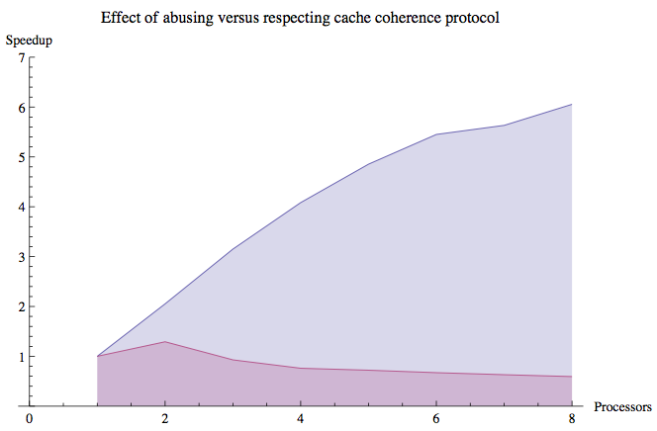
Impact of Cache Coherence in Multicore CPUs
Notes:
Imagine one core accessing a large two-dimensional array in row-major order and another core accessing a large two-dimensional array in column-major order.

Slide 32
Compiler Optimizations
Blocking
Instead of accessing entire rows or columns, subdivide matrices into blocks
Requires more memory accesses but improves locality of accesses
/* Before */ /* After */
for (i=0; i<N; i++) for (jj=0; jj<N; jj+=B)
for (j=0; j<N; j++) for (kk=0; kk<N; kk+=B)
{ r=0; for (i=0; i<N; i++)
for (k=0; k<N; k++) for (j=jj; j<min(jj+B,N); j++)
r=r+y[i][k]*z[k][j]; { r=0;
x[i][j] += r; for (k=kk; k<min(kk+B,N); k++)
}; r=r+y[i][k]*z[k][j];
x[i][j] +=r;
}
Notes:
To ensure array elements being accessed can fit in the $, original code is changed to compute on a submatrix of size B by B.
Two inner loops now compute in steps of size B rather than the full length of x and z. B is called the blocking factor.
BEFORE: 2N^3 + N^2 memory words accessed for N^3 operations.
AFTER: 2N^3/B + N^2 memory words accessed for N^3 operations.
Improvement by factor of B.
Blocking exploits a combination of spatial and temporal locality, since y benefits from spatial locality and z benefits from temporal locality.
This reduced cache misses, but it could even be used to help with register allocation, particularly for GPUs with large register files → keep B small. Everything stays in registers.

Slide 33
Advanced Optimizations for Caching
Reduce Hit Time
(1) Small & simple first-level $ and (2) way prediction
Side effect: Reduce power consumption
Increase Cache Bandwidth
(3) Pipelined $, (4) non-blocking $, and (5) multi-banked $
Side effect: Varying impacts on power consumption
Reduce Miss Penalty
(6) Critical word first and (7) merging write buffers
Side effect: Little impact on power
Reduce Miss Rate
(8) Compiler optimizations. Side effect: Reduces power consumption
Reduce Miss Penalty or Miss Rate via Parallelism
(9) Hardware pre-fetching and (10) compiler pre-fetching
Key
$ = cache
Notes:
Pre-fetching generally increases power consumption, primarily due to prefetched data that is unused.

Slide 34
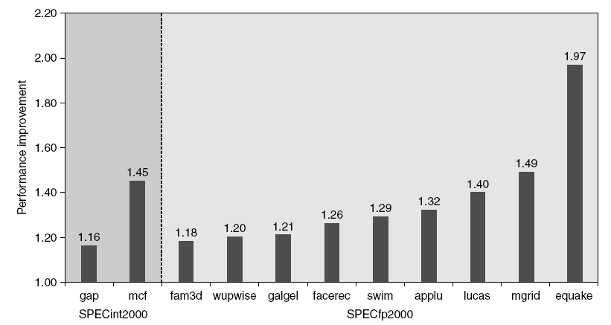
Hardware Prefetching
Fetch two blocks on miss (include next sequential block)
Pentium 4 Pre-fetching
Notes:
Nonblocking caches effectively reduce miss penalty by overlapping execution with memory access. Another way?
Prefetch items before CPU requests them. Instruction or data.
I-fetch: Done in hardware outside the cache in a stream buffer. CPU fetches two blocks on a miss.
Requested block into i-$.
Prefetched block into instruction stream buffer.
Subset of SPEC2000 benchmarks shown. 15 missing ones only improve performance by < 15%.

Slide 35
Compiler Prefetching
Insert prefetch instructions before data is needed
Non-faulting: prefetch doesn’t cause exceptions
Register prefetch
Loads data into register
Cache prefetch
Loads data into cache
Combine with loop unrolling and software pipelining
Notes:
Faulting pre-fetch occurs when the address causes an exception for virtual address faults and protection violations.
Using this terminology, a normal load instruction could be considered a “faulting register prefetch instruction.”
Non-faulting prefetches simply turn into no-ops.

Slide 36
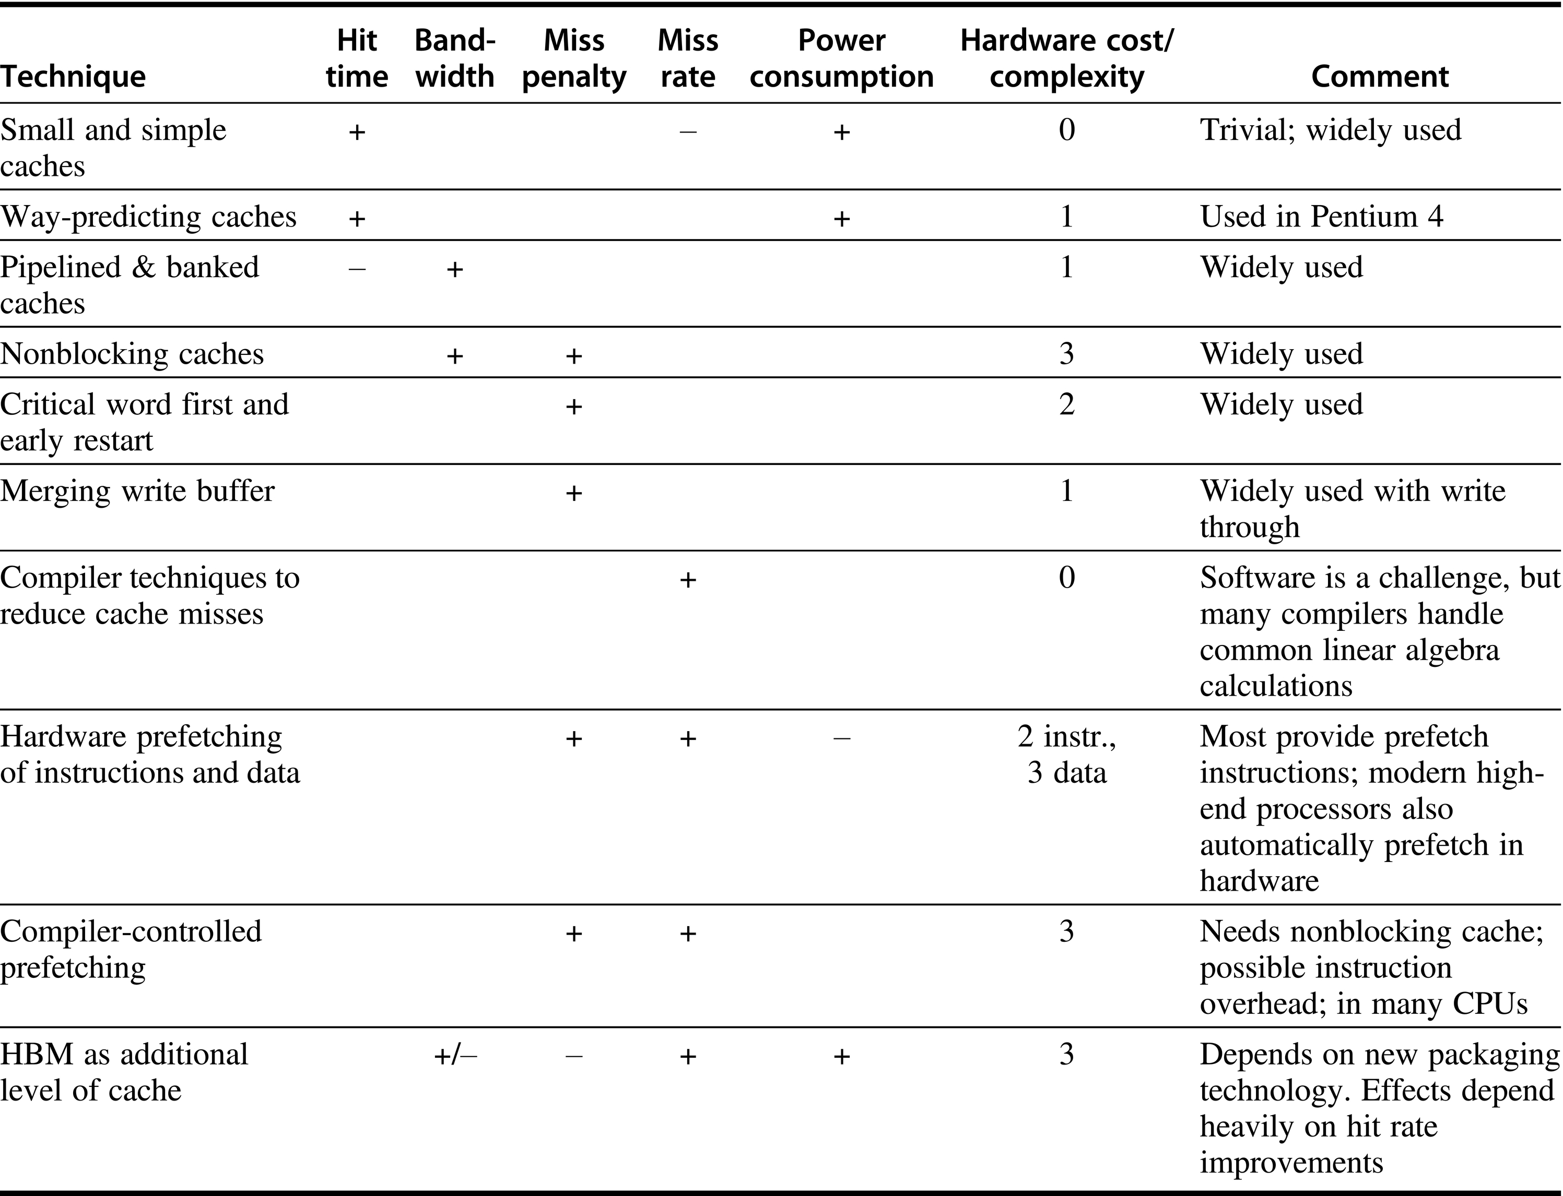
Summary of Advanced $ Optimizations
Notes:
Summary of 10 advanced cache optimizations showing impact on cache performance, power consumption, and complexity. Although generally a technique helps only one factor, prefetching can reduce misses if done sufficiently early; if not, it can reduce miss penalty.
+ means positive impact. - negative impact. Blank means no impact
0 means easiest. 3 means hardest.

Slide 37
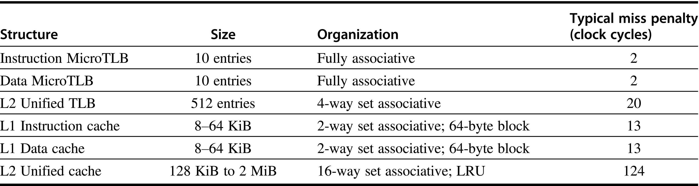
Memory Technology: ARM Cortex A53

Slide 38
Memory Technology
Performance Metrics
Latency is a concern of cache
Bandwidth is a concern of multiprocessors and I/O
Access time
Time between read request and when desired word arrives
Cycle time
Minimum time between unrelated requests to memory
DRAM used for main memory, SRAM used for cache

Slide 39
Memory Technology
SRAM
Requires low power to retain bit
Requires six transistors/bit
DRAM
Must be re-written after being read
Must also be periodically refreshed
Every ~ 8 ms
Each row can be refreshed simultaneously
Only one transistor/bit
Address lines are multiplexed:
Upper half of address: row access strobe (RAS)
Lower half of address: column access strobe (CAS)

Slide 40
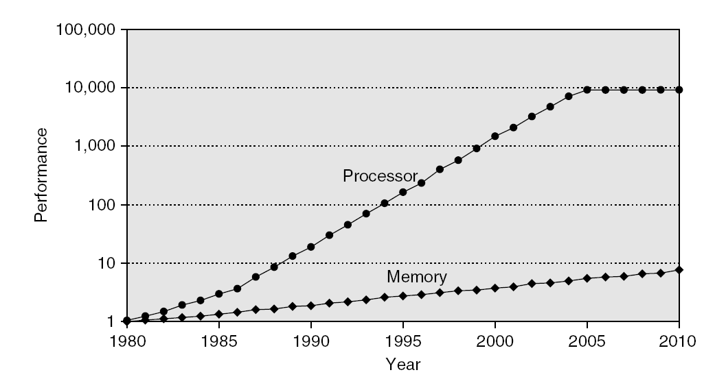
Memory Technology
Amdahl
Memory speed should grow linearly with processor speed
Unfortunately, memory speed has not kept pace with processors
Optimizations
Multiple accesses to same row
Synchronous DRAM
Added clock to DRAM interface
Burst mode with critical word first
Wider interfaces
Double data rate (DDR)
Multiple banks on each DRAM device
Recall
Notes:
TRUE / FALSE question. A computer bus operating with double data rate (DDR) transfers data on both the rising and falling edges of the clock signal.

Slide 41
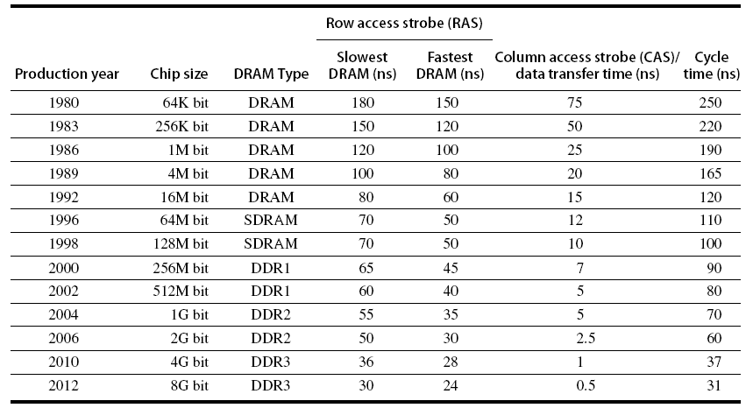
Memory Technology + Optimize
Notes:
Figure 2.13
A computer bus operating with double data rate (DDR) transfers data on both the rising and falling edges of the clock signal.

Slide 42
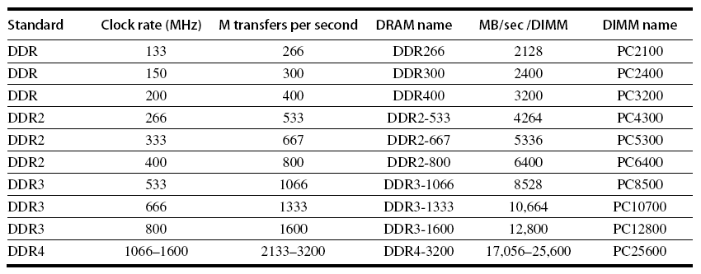
Memory Optimizations
Notes:
Figure 2.14. This should be updated.

Slide 43
Memory Optimizations
DDR
DDR2
Lower power (2.5 V → 1.8 V)
Higher clock rates (266 MHz, 333 MHz, 400 MHz)
DDR3
1.5 V
800 MHz
DDR4
1-1.2 V
1600 MHz
GDDR5 is graphics memory, based on DDR3
GDDR6 successor offers increased per-pin bandwidth (up to 16 Gbit/s^{[3]}) and lower operating voltages (1.35 V^{[4]}).
Notes:
An abbreviation for double data rate type five synchronous graphics random access memory
2008: GDDR5 is based on DDR3 SDRAM memory, which has double the data lines compared to DDR2 SDRAM.
GDDR5 also uses 8-bit wide prefetch buffers (similar to GDDR4 and DDR3 SDRAM).
2018: GDDR6 offers increased per-pin bandwidth (up to 16 Gbit/s^{[3]}) and lower operating voltages (1.35 V^{[4]}),
increasing performance and decreasing power consumption relative to GDDR5X.^{[5][6]}

Slide 44
Memory Optimizations
Graphics Memory
Achieve 2x-5x bandwidth per DRAM vs. DDR3
Wider interfaces (32 vs. 16 bit)
Higher clock rate
Possible because they are attached via soldering
instead of socketed DIMM modules
Reducing Power in SDRAMs
Lower voltage
Low power mode (ignores clock, continues to refresh)

Slide 45
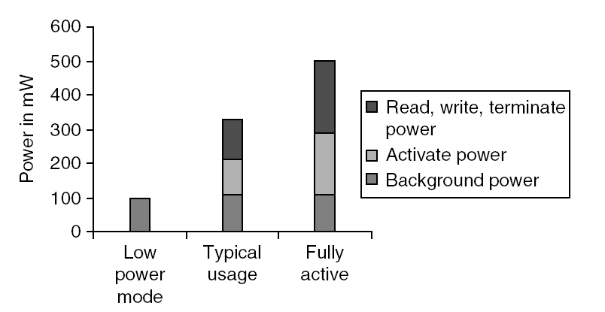
Memory Power Consumption

Slide 46
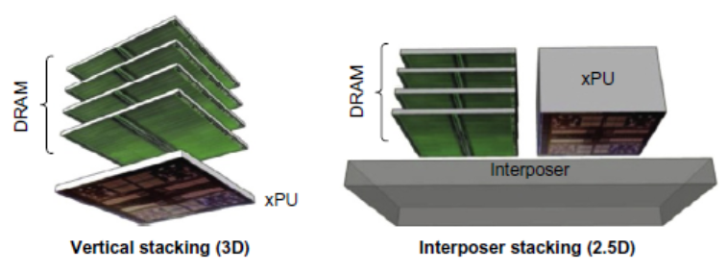
Stacked/Embedded DRAMs
Stacked DRAMs in same package as processor
High Bandwidth Memory (HBM)

Slide 47
Flash Memory
Type of EEPROM
Types: NAND (denser) and NOR (faster)
NAND Flash:
Reads are sequential, reads entire page (0.5 to 4 KiB)
25 μs for first byte, 40 MiB/s for subsequent bytes
SDRAM
40 ns for first byte, 4.8 GB/s for subsequent bytes
2 KiB transfer
75 μs vs. 500 ns for SDRAM, 150x slower
300 to 500x faster than magnetic disk
Notes:
Electrically Erasable Programmable Read-Only Memory

Slide 48
NAND Flash Memory
Must be erased (in blocks) before being overwritten
Nonvolatile, can use as little as zero power
Limited number of write cycles (~100,000)
$2/GiB, compared to $20-40/GiB for SDRAM and $0.09 GiB for magnetic disk
Phase-Change/Memrister Memory
Possibly 10X improvement in write performance and 2X improvement in read performance

Slide 49
Memory Dependability
Memory is susceptible to cosmic rays
Soft errors: dynamic errors
Detected and fixed by error correcting codes (ECC)
Hard errors: permanent errors
Use sparse rows to replace defective rows
Chipkill: A RAID-like error-recovery technique

Slide 50
Virtual Memory
Protection via virtual memory
Keeps processes in their own memory space
Role of architecture
Provide user mode and supervisor mode
Protect certain aspects of CPU state
Provide mechanisms for switching between user mode and supervisor mode
Provide mechanisms to limit memory accesses
Provide TLB to translate addresses
Notes:
A translation lookaside buffer (TLB) is a cache that memory management hardware uses to improve virtual address translation speed.
Think of the TLB as a cache for virtual-to-physical address translations

Slide 51
Virtual Machines
Supports isolation and security
Sharing a computer among many unrelated users
Enabled by raw speed of processors, making the overhead more acceptable
Allows different ISAs and operating systems to be presented to user programs
“System Virtual Machines”
SVM software is called “virtual machine monitor” (VMM) or “hypervisor”
Individual virtual machines run under the monitor are called “guest VMs”

Slide 52
Requirements of VMM
Guest software should:
Behave on as if running on native hardware
Not be able to change allocation of real system resources
VMM should be able to “context switch” guests
Hardware must allow:
System and use processor modes
Privileged subset of instructions for allocating system resources

Slide 53
Impact of VMs on Virtual Memory
Each guest OS maintains its own set of page tables
VMM adds a level of memory between physical and virtual memory called “real memory”
VMM maintains shadow page table that maps guest virtual addresses to physical addresses
Requires VMM to detect guest’s changes to its own page table
Occurs naturally if accessing the page table pointer is a privileged operation

Slide 54
Cache Coherence & Performance
Summary
Unlike details with pipelining (e.g., ILP) that only concern compiler writers, you the programmer need to acknowledge that cache coherence is going on “under the covers.” Why?
The coherence protocol can DRAMATICALLY impact your performance!

Slide 55
Impact of Cache Coherence in Multicore CPUs
Notes:
Just changed the interleaving of memory accesses between the processing cores.
Make a quiz question with traversal pattern.

